Slide 1

Quantum Computing with Qiskit : Phase II
Pawel Pratyush
Vrushali Shinde

Slide 2
Introduction
This phase presentation will focus on the algorithms implemented using Qiskit

Slide 3
Simulator
The algorithms are executed using qasm simulator as backend.
Other qiskit simulator like unitary or statevector do not perform measurements and are better suited for intermediate simulation behavior analysis
Pulse simulator is used for simulation of behavior of superconducting qubits. I.e. ones with current and voltage.
Hence, Aer.get_backend('qasm_simulator')

Slide 4
Time and Memory
import timeit
We want to measure the execution time for repetitive block of code for different qubits
Other time imports mostly focus on overall execution
import tracemalloc
Simple to read
Start and stop as per the block of code we want

Slide 5
Bernstein Vazirani Algorithm
The algorithm takes the hidden string whose length is equal to the number of qubits. The string is encoded and then decoded after series of gates and output is observed to have got the same hidden string.

Slide 6
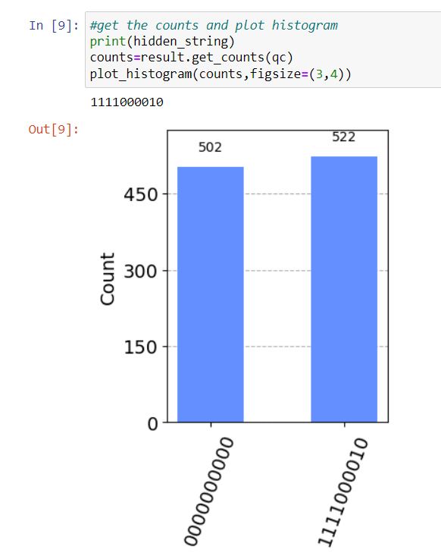
Histogram of 10 qubit Bernstein-Vazirani

Slide 7
2. Deutsch Algorithm
The function is observed to be balanced or constant.
A balanced function is the one where we get o and 1 with equal probability and the constant function is the one which will return either zero or one

Slide 8
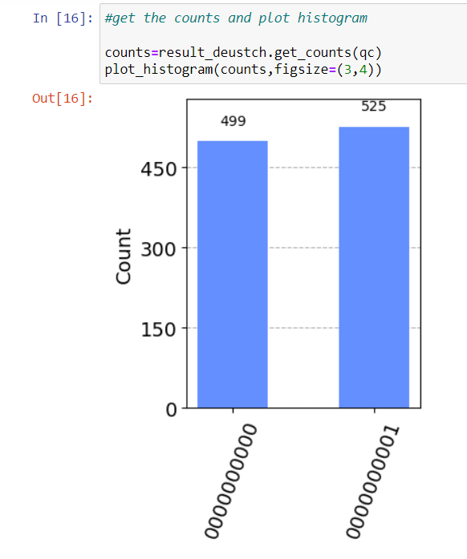
Histogram of 10 qubit Deutsch

Slide 9
3. Grover’s Algorithm
Grover’s algorithm in qiskit is given the item at the specified indices in the given list and then the algorithm is searching for the solution that corresponds to those indices

Slide 10
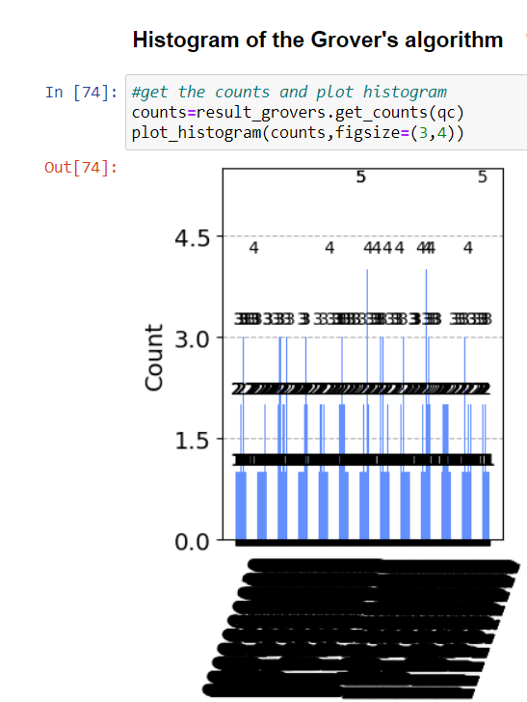
Histogram of 10 qubit Grover’s

Slide 11
4. Shor’s Algorithm
The algorithm returns the GCD of the input number after applying the series of gates in circuit

Slide 12
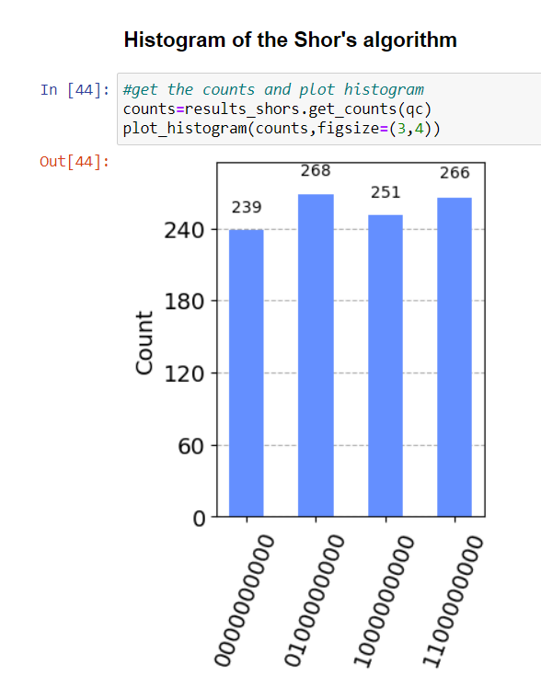
Histogram of 10 qubit Shor’s

Slide 13
5. Simon’s Algorithm
Simon’s algorithm outputs similar to bernstein-vazirani. I.e. identifying the hidden string which is encoded using hadamard gate and then oracle function(cnot gates) and again hadamard to decode the string.

Slide 14
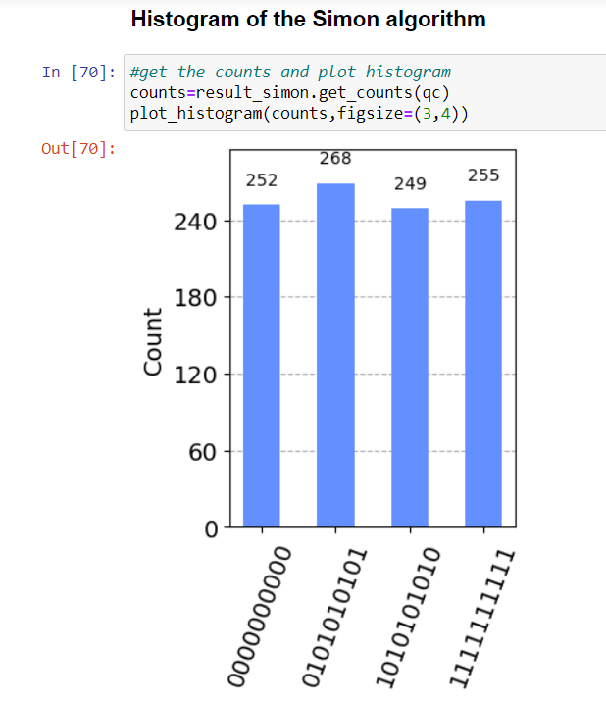
Histogram of 10 qubit Simon’s Algorithm

Slide 15
Ideal Time Observation
The Bernstein-Vazirani algorithm can be implemented in Qiskit by making a single call to the oracle. The algorithm's time complexity is O(n), where n is the quantity of qubits.
Simon algorithm: The Simon method can be used in Qiskit by making several calls to the oracle. The algorithm's time complexity is O(n2), where n is the quantity of qubits.
The Deutsch-Jozsa algorithm can be implemented in Qiskit by making a single call to the oracle. No matter the number of qubits, the algorithm's temporal complexity is O(1).
Shor's algorithm: The Quantum Fourier Transform (QFT) is one of the quantum circuits that can be used in Qiskit to execute the Shor's algorithm. The algorithm's temporal complexity is O((log N)3), where N is number to be factored
Grover's algorithm: In Qiskit, a quantum circuit with many Grover iterations can be used to implement Grover's algorithm. The algorithm has an O(N) time complexity, where N is the size of the search space

Slide 16
Ideal Memory Observation
The qasm simulator used by Qiskit is designed to use memory efficiently by simulating the quantum operations on a classical computer without storing the full state of the quantum system in memory. This means that the memory usage of the simulator should not be a limiting factor in most cases.

Slide 17
What we observed
Every algorithm is seen as behaving differently.
Although ideally, yes it should increase exponentially as we increase the number of qubits; certain abnormalities are observed in terms of memory, time plot line being constant or even decreasing as we increase the number of qubits.
Note that these implementations are one way for the algorithm to work. There are multiple ways to perform and each way will give different results

Slide 18
Thank You!
Pawel Pratyush
Vrushali Shinde

